Slide 1
Parkinson’s Disease Prediction Using Machine Learning
Submitted by-
Arijeet Purkayastha
Girijananda Chowdhury University , Guwahati

Slide 2
Problem Statement
Parkinson’s Disease (PD) is a progressive neurodegenerative disorder. Diagnosis traditionally relies on clinical evaluations, which can be subjective and costly.
Why it matters?
Vocal impairment is often one of the earliest signs of PD. Developing a non-invasive, machine learning-based diagnostic tool using voice recordings can enable earlier, more accessible, and objective screening.

Slide 3
Project Objective
To design and evaluate a robust machine learning pipeline that accurately classifies a patient as "Healthy" (0) or "Parkinson's" (1) based on biomedical voice measurements.

Slide 4
Dataset Description
The Oxford Parkinson's Disease Detection Dataset is a well-known dataset from the UCI Machine Learning Repository. It consists of a range of biomedical voice measurements from 31 different people, 23 of whom have Parkinson's disease (PD). The file contains 195 total rows, with each row representing a specific voice recording from one of those individuals.
The data extracted for model training consists of various mathematical measures of vocal characteristics. The goal of using these specific features is to detect subtle vocal tremors, breathiness, and changes in speech complexity that are common early symptoms of Parkinson's disease.
Source: https://archive.ics.uci.edu/dataset/174/parkinsons
Size: 195 voice recordings from 31 distinct individuals.
Features: 22 numerical acoustic features, including fundamental frequencies (MDVP:Fo(Hz)), variation in frequency (Jitter), variation in amplitude (Shimmer), and noise-to-harmonics ratios (NHR,HNR).
Target Variable: status (0 = Healthy, 1 = Parkinson's).

Slide 5
Data Pre-processing
Data Cleansing: Verified 0 missing values across all 25 columns.
Feature Engineering: Extracted subject_id from the raw name column to track individual patients and prevent data leakage.
Feature Selection:
Dropped non-predictive columns (name, subject_id) from the feature matrix (X).
Then, applied Recursive Feature Elimination with Cross-Validation (RFECV) to mathematically reduce the 22 acoustic features down to the 5 most critical biological markers.
Scaling: Applied StandardScaler to normalize the wide mathematical ranges of the selected acoustic features.

Slide 6
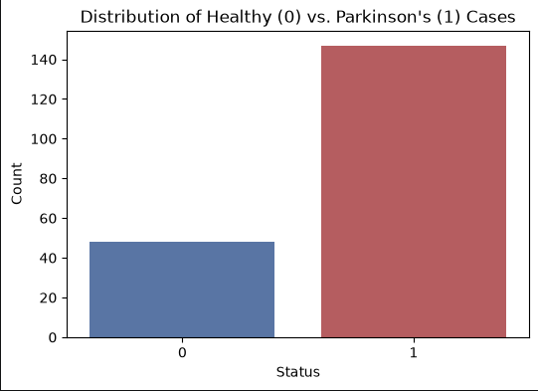
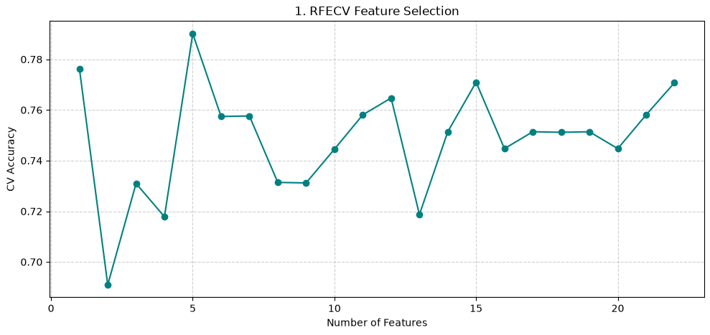
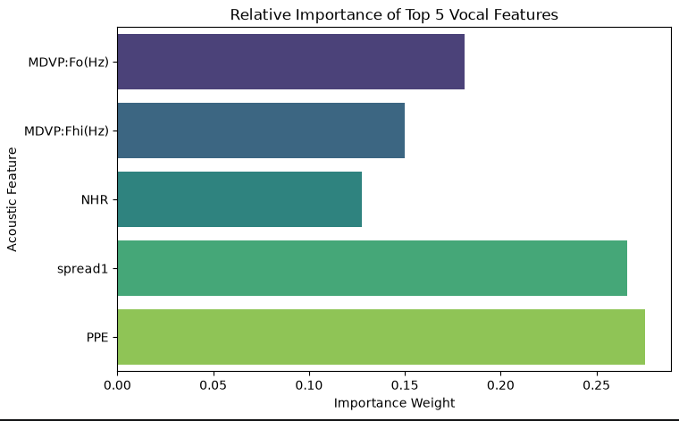
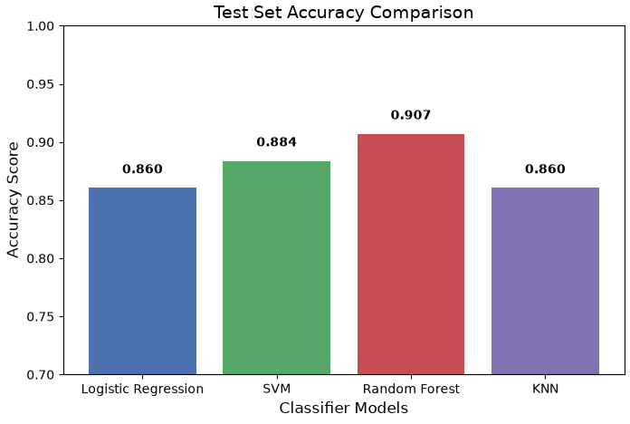
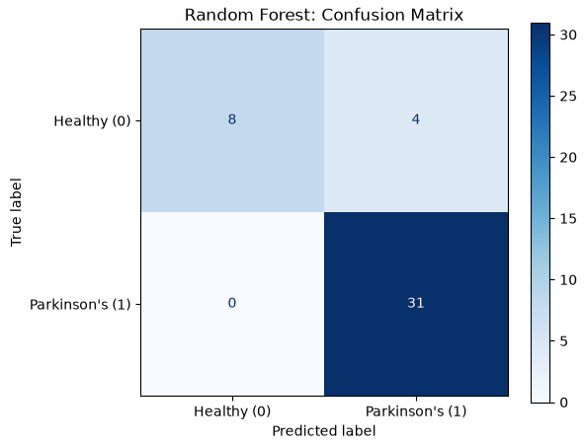
EDA & Visual Insights
1. Distribution of Healthy (0) vs. Parkinson's (1) Cases (Bar Chart)
2. RFECV Feature Selection (Line Graph)
3.Relative Importance of Top 5 Vocal Features(Bar Chart)
The dataset suffers from a severe class imbalance, containing 147 Parkinson's cases compared to only 48 Healthy cases (roughly a 3:1 ratio).
The curve visually demonstrates how model performance shifts as features are added or removed. It peaks exactly at 5 features, proving that the remaining 17 features were either adding mathematical "noise" or redundant information.
PPE (Pitch Period Entropy) and spread1 are the most dominant predictors, each carrying a high importance weight of over 0.25. (MDVP:Fo(Hz) and MDVP:Fhi(Hz)) and the noise ratio (NHR) are also critical but carry noticeably less weight than the non-linear features.
4. Test Set Accuracy Comparison (Bar Chart)
5.Random Forest: Confusion Matrix (Heatmap)
Random Forest achieved a top accuracy of 0.907 (90.7%) on the isolated test set. SVM is a close second at 0.884, while Logistic Regression and KNN tie at 0.860.
The model achieved a Recall of 1.00 for Parkinson's patients. This means the confusion matrix will show 0 False Negatives.

Slide 7
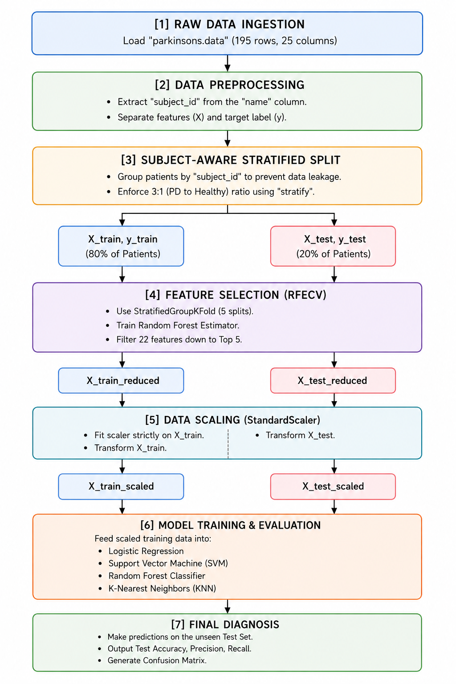
Methodology
Flowchart created using AI

Slide 8
Models Implemented
Logistic Regression - Logistic Regression is a supervised machine learning algorithm used for classification problems. It is used for binary classification where the output can be one of two possible categories such as Yes/No, True/False or 0/1.It uses sigmoid function to convert inputs into a probability value between 0 and 1.
Support Vector Machine - Support Vector Machine (SVM) is a supervised machine learning algorithm used for classification and regression tasks. It tries to find the best boundary known as hyperplane that separates different classes in the data.
Random Forest - Random Forest is a machine learning algorithm that uses many decision trees to make better predictions. Each tree looks at different random parts of the data and their results are combined by voting for classification or averaging for regression which makes it as ensemble learning technique.
K-Nearest Neighbors - K‑Nearest Neighbor (KNN) is a simple and widely used machine learning technique for classification and regression tasks. It works by identifying the K closest data points to a given input and making predictions based on the majority class or average value of those neighbors.

Slide 9
Model Evaluation
Model | Test Accuracy | PD Precision | PD Recall
Random Forest | 90.7% | 0.89 | 1.00
SVM (RBF) | 88.4% | 0.86 | 1.00
Logistic Regression | 86.0% | 0.86 | 0.97
KNN (k=3) | 86.0% | 0.84 | 1.00

Slide 10
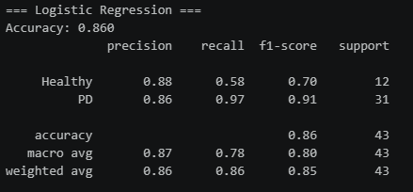
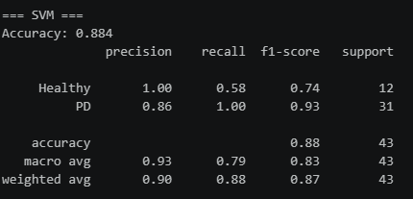
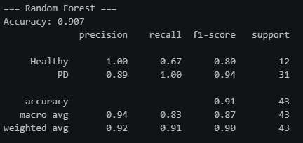
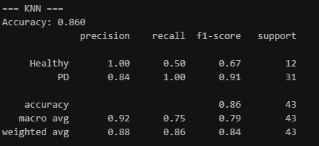
Prediction Demo

Slide 11
Results, Conclusion & Limits
Machine learning can accurately detect Parkinson's disease from voice alone. Tree-based ensemble models (Random Forest) outperformed distance-based models.
Learnings : Learned to implement patient-aware grouping (StratifiedGroupKFold) so the algorithm learns the disease, not the individual's specific voice.
Limitations : The dataset is relatively small (195 recordings). A 3:1 class imbalance makes False Positives slightly harder to evaluate than False Negatives.

Slide 12
Future Scope & GitHub
Future Work
Add other machine learning models and implement deep learning.
Work on bigger datasets with different kind of data/features.
Project Repository
GitHub Link: https://github.com/Arijeet0615/Parkinsons-Disease-Prediction-PBEL-PROJECT-

Slide 13
Thank you

